Slide 1
Nottingham Battle of the Neighbourhoods
Coursera Capstone Project May 2020

Slide 2
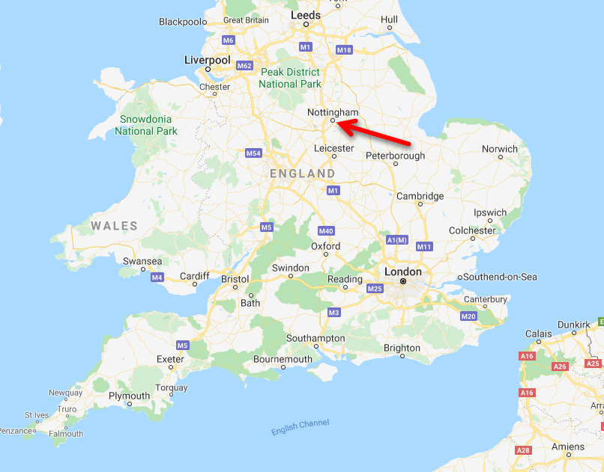
Nottingham – Battle of the Neighbourhoods
Introduction / Problem
Data – Crime
Data - Restaurants
Methodology
Results (1-6)
Conclusions

Slide 3
Introduction / Problem
Nottingham is regional City in the UK
2 Universities
Population of Wider Urban Area ~733,000
Sixth highest Tourist spending in UK.
Vibrant and Busy Nightlife
Crime & Distruption
Problem
Need to asses the best choice of area within Nottingham for the placement of a Restaurant Venue with respect to being in areas currently frequented by customers (in established businesses) and taking into account the local crime rate.

Slide 4
Data - Crime
Reported Crime
Downloaded from UK Police Data portal https://data.police.uk/
ZIP files per Force per Month. Select 12 Months for Nottinghamshire Police in 2019.
Information on Month, Crime Type, Latitude, Longitude, Location
Filter out data for locations outside the Nottingham Urban Area.
Locations
Crime Data grouped by LSOA – Lower Layer Super Output Area – used by UK Office of National Statistics (ONS) for reporting purposes.
Linked to MSOA – Middle Layer Super Output Area
Linked to Borough
Both have population weighted Centroids provided by ONS

Slide 5
Data - Restaurants
Foursquare
Use API to select data close to given Locations
Venue information includes Latitude, Longitude, Venue Category
Filtered on Venue Category = Restaurant
Selection Criteria
400m from MSOA Centroid – 156 Venues Found, hardly any in City Centre
300m from LSOA Centroid (crime weighted) – 842 Venues Found –Many in City Centre.
Use LSOA for Grouping

Slide 6
Methodology
Regression Plot : Crime vs Restaurants
Standardise Numbers of Crimes and Venues by expressing them as multiples of the mean.
K-Means Grouping all LSOA
Group for all LSOAs in the Nottingham Urban Area
Group By number of Venues (Restaurants) and number of Crimes
Includes LSOAs without venues
K-Means Grouping LSOA with Venue
Group only LSOA with venue
Recalculate Average number of venues
Focus on grouping of existing Restuarants

Slide 7
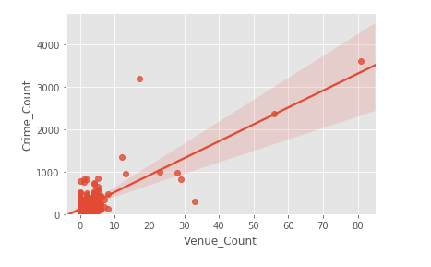
Results 1 – Regression scatter plot

Slide 8
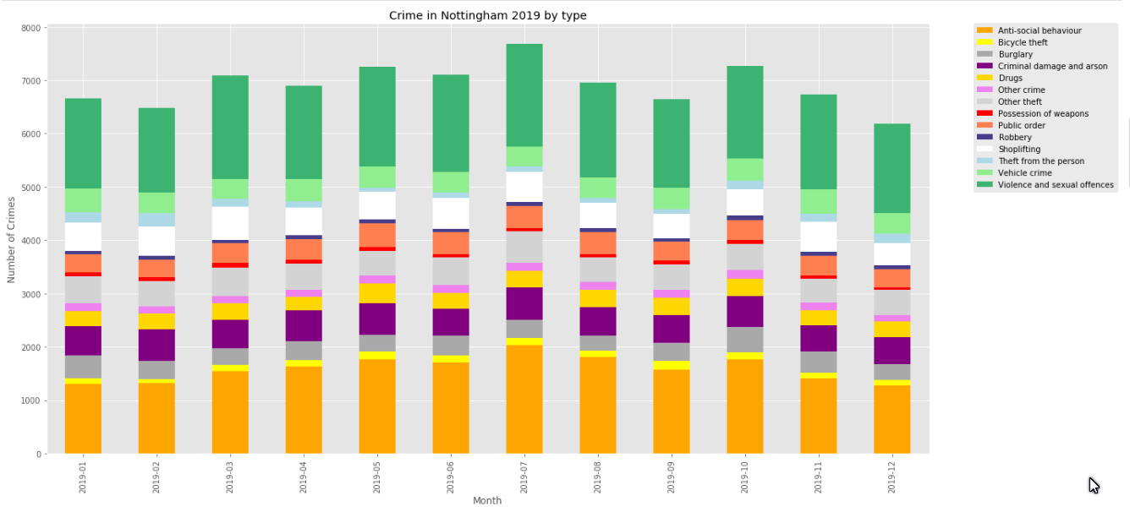
Results 2 - Monthly Crime in Nottingham 2019 by Crime Type

Slide 9
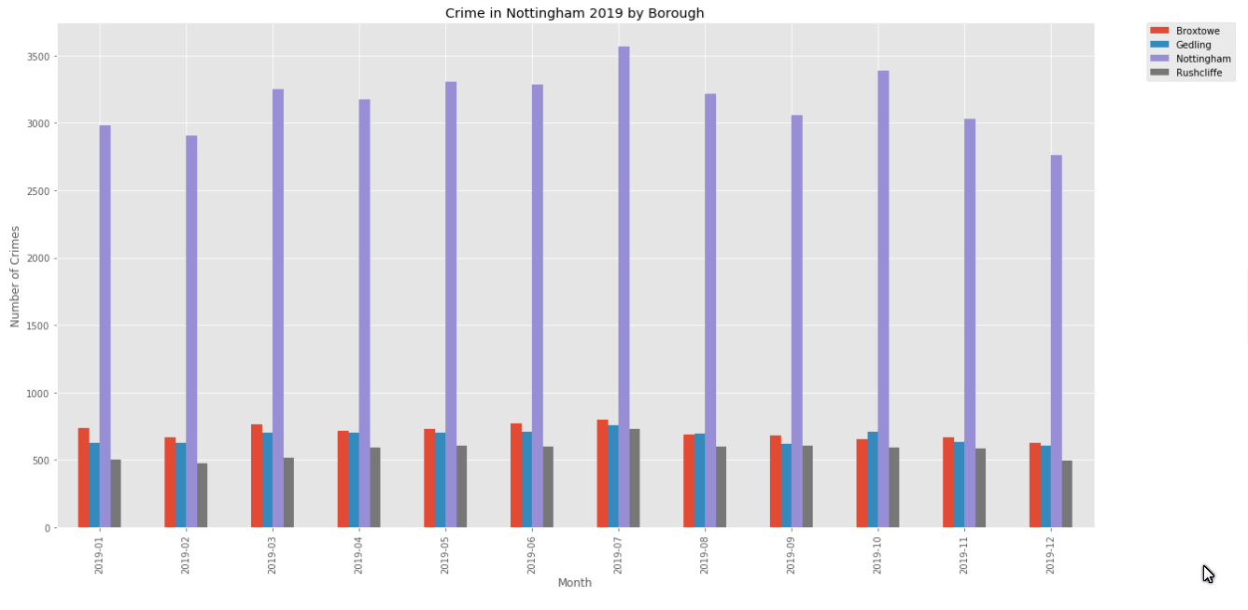
Results 3 – Monthly Distribution of Crime by Borough

Slide 10
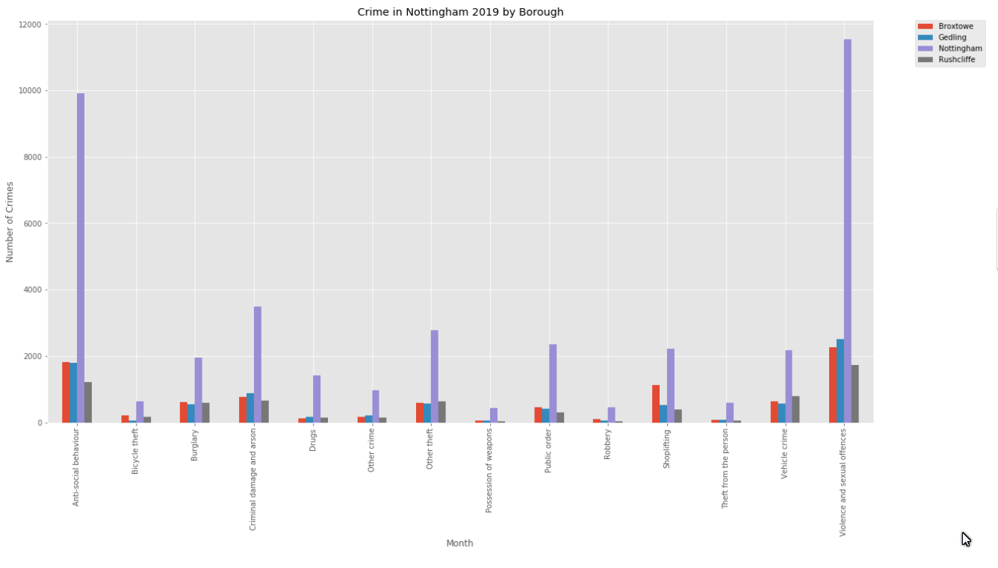
Results 4 – Distribution of Crime by Type in Borough

Slide 11
Result 5(a) Grouping for all LSOAs
Cluster | Crime Rate |  | Venue Frequency |  | Number of LSOAs
 | mean | Std Dev | mean | Std Dev
0 | 0.650213 | 0.406732 | 0.282652 | 0.390328 | 296
1 | 14.333932 | 4.143845 | 32.378860 | 8.355953 | 2
2 | 1.543948 | 1.110894 | 1.980298 | 0.889122 | 95
3 | 15.358642 | NaN | 8.035629 | NaN | 1
4 | 3.708872 | 1.570840 | 13.353325 | 1.944144 | 4

Slide 12
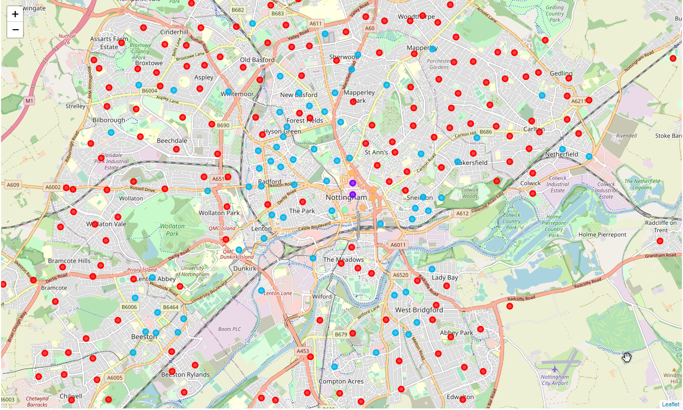
Result 5(b) Grouping for all LSOAs - Map

Slide 13
Result 6(a) - Clustering LSOAs (with venues)
Cluster | Crime Rate |  | Venue Frequency |  | Number of LSOAs
 | mean | Std Dev | mean | Std Dev
0 | 0.697807 | 0.349701 | 0.598063 | 0.381444 | 167
1 | 14.333932 | 4.143845 | 17.816508 | 4.597874 | 2
2 | 15.358642 | NaN | 4.421615 | NaN | 1
3 | 4.302020 | 1.636177 | 5.982185 | 2.273415 | 6
4 | 2.219078 | 0.737279 | 1.004088 | 0.426932 | 43

Slide 14
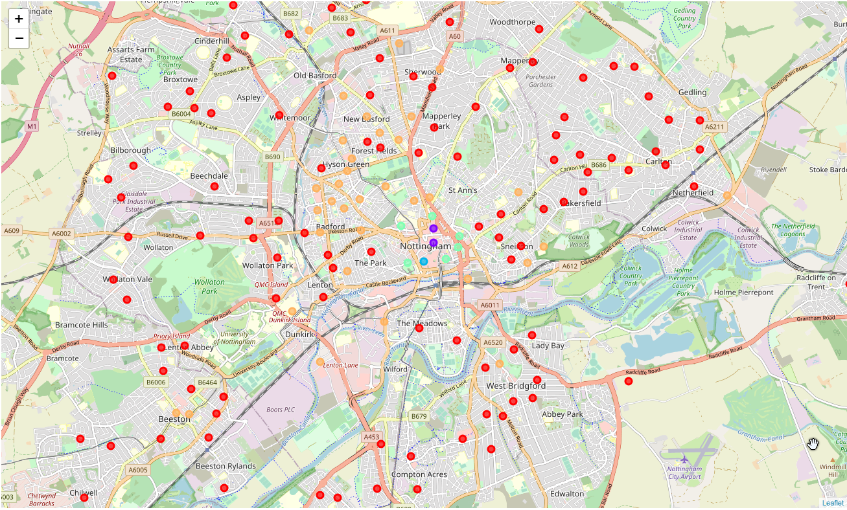
Result 6(a) - Clustering LSOAs (with venues)

Slide 15
Conclusions
Model for LSOAs with Venues is a refinement of the model for all LSOAs
No causal relationships between Restaurants and Crime
Crime happens where people are.
Need better breakdown of stats – Crime Type, Day of Week.
Crime rate Highest in City Centre
Restaurant Frequency Highest in City Centre
Model would be improved
Use of Foursquare premium data
More complete Restaurant data
Cost data – taxes, insurance, rent.

